Slide 1

INSAID - Feb’20’ Cohort
EDA Term 1 & 2 Project Submission
“1000 Movies Data”
By : Nirmal Sagar

Slide 2

“ON A FILM SET NOW, IT’S ROBOTS, IT’S DRONES, IT’S SUPER HIGH-TECH, BUT THE BUSINESS SIDE HASN’T EVOLVED IN 20 YEARS.”
“AI will tell you who to cast and predict how much money you’ll make”
Problem Statement :
Understand the trend in revenue, ratings, Metascore, votes for different movie genres over years (from 2006 to 2016) and Correlation between the trends for Top genres (Drama, Action, Adventure, Animation, Comedy, Romance, Thriller, Crime, Horror, Sci-Fi, Fantasy and Musical).

Slide 3
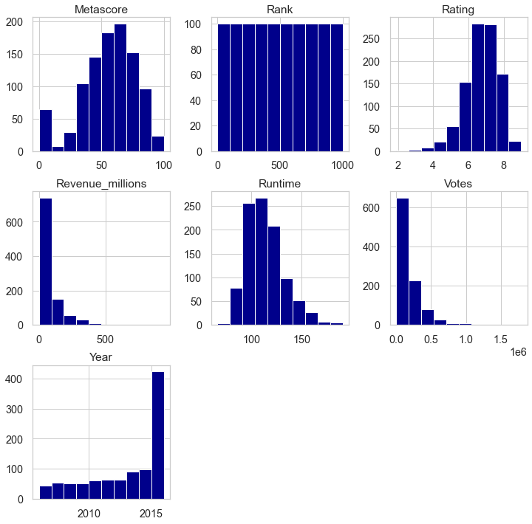
1000 Movies Histogram Map

Slide 4
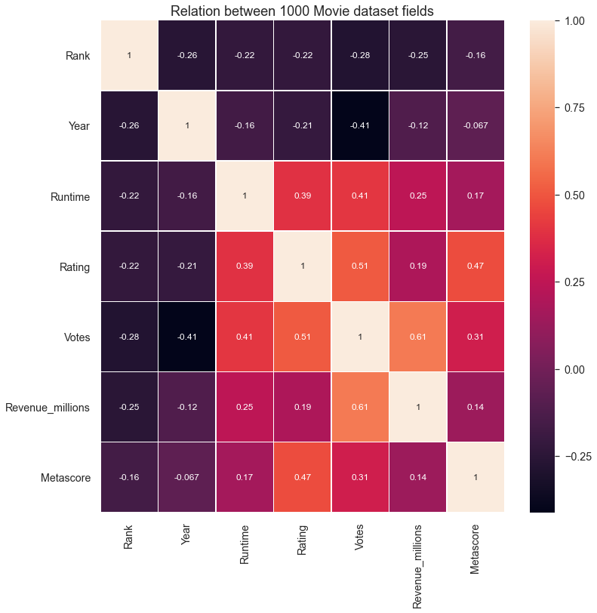
1000 Movies Correlation Map we see strong correlation is between Rating and Metascore (0.47), Votes and Rating (0.51) and top in order is between Revenue (Millions) and Votes (0.61).

Slide 5
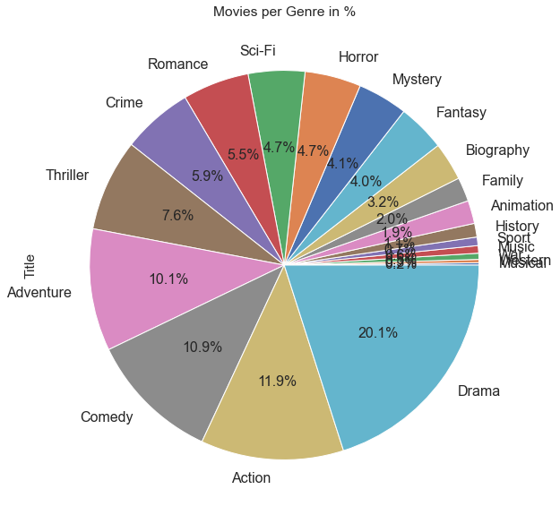
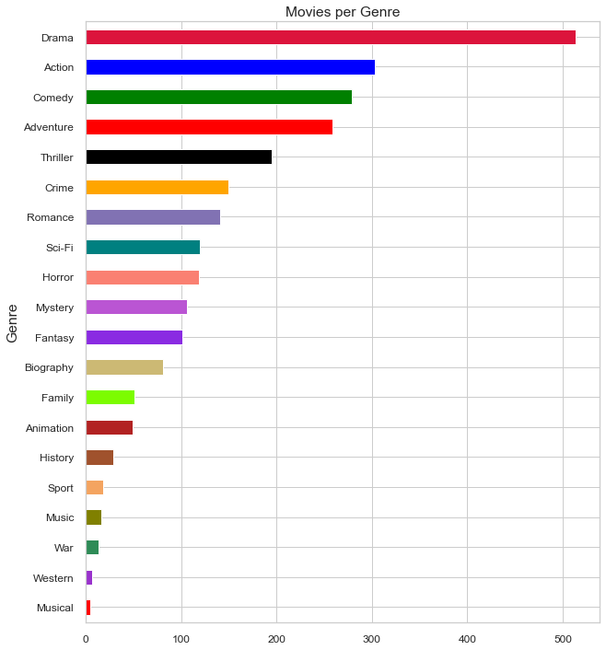
Which genres are the most common (number of movies made in % )?

Slide 6
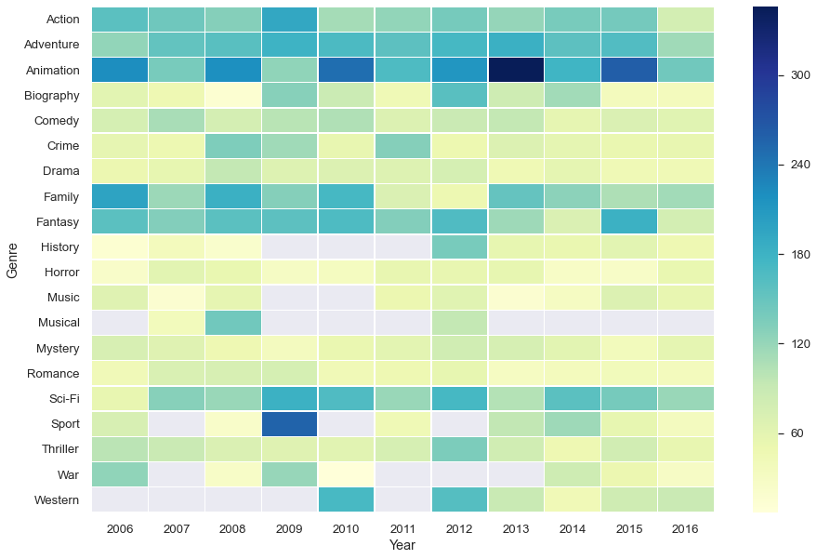
What is the Avg. Revenue (Millions) per Genre per Year?
Below plot shows a strong increase in revenue for Adventure, Animation, Action, Family, and Science Fiction over the years. We can also observe in the year 2013, Animated movies are highly Revenue (Millions) generated movies.

Slide 7
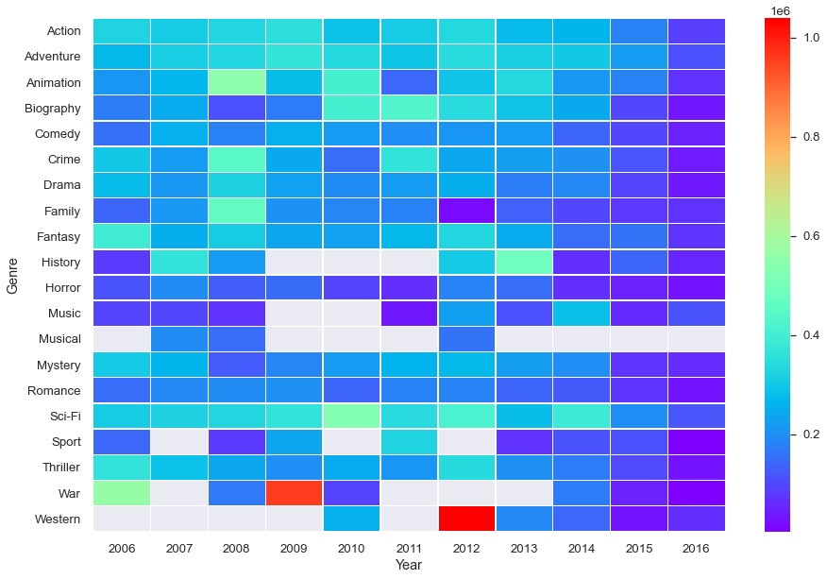
What is the Avg. Votes per Genre per Year of 1000 Movies dataset?
We can see in 2012 people casted the maximum votes on Genre of fiction called Western and also showed there interest towards Sci-Fi Genre movies.
We can say that as the number of movies has increased of variegated Genre, user's votes are also diversified, which will cause a drop in average revenue per year.

Slide 8
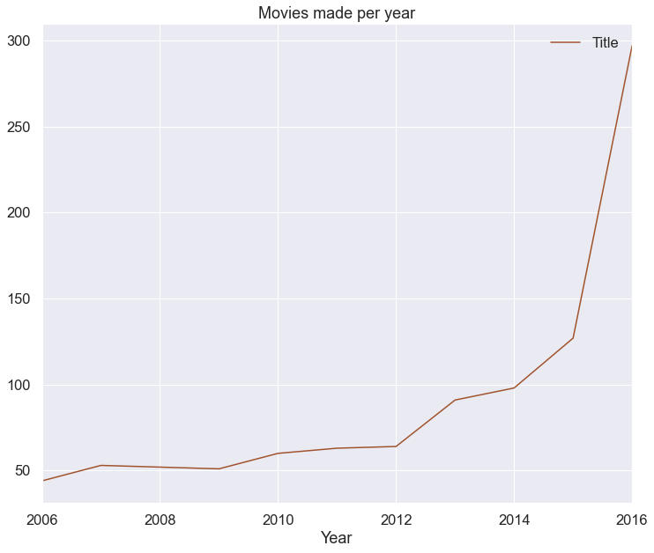
How many Movies made per Year per Genre?
We can see that over time more and more movies were made per year. Starting at just 44 movies in 2006 to 127 movies in 2015 with a max of 297 movies in 2016.
We can say as various types of Genre are introduced and clubbed together, the movies made per year is increasing.

Slide 9
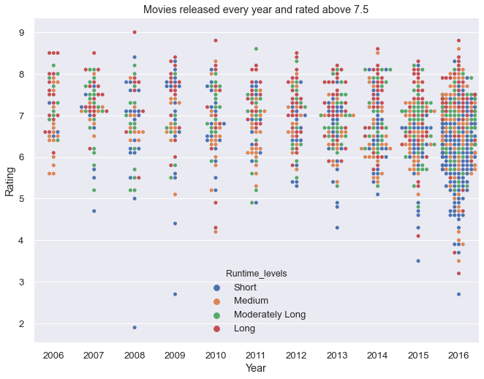
How many movies released every year and rated above 7.5 with relation with Runtime Levels?

Slide 10
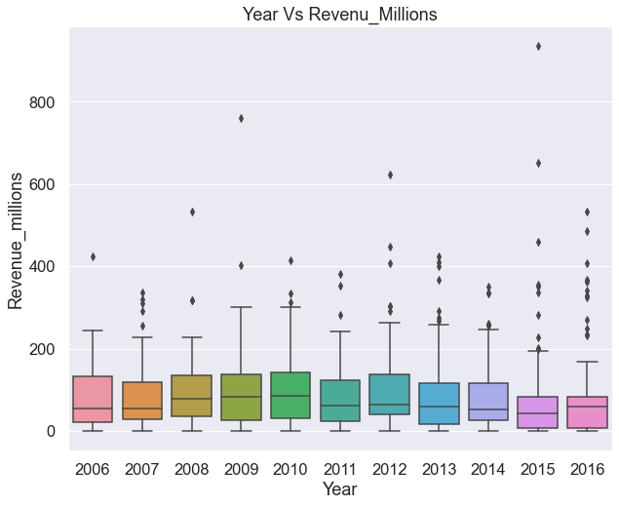
What is the range of Revenue (Millions) of Movies generated per Year?
From 2006-2016 most movies have the revenue in between 0-300 millions approx. with outliers every year. Where in 2016 there are many outliers as compared with other years.

Slide 11
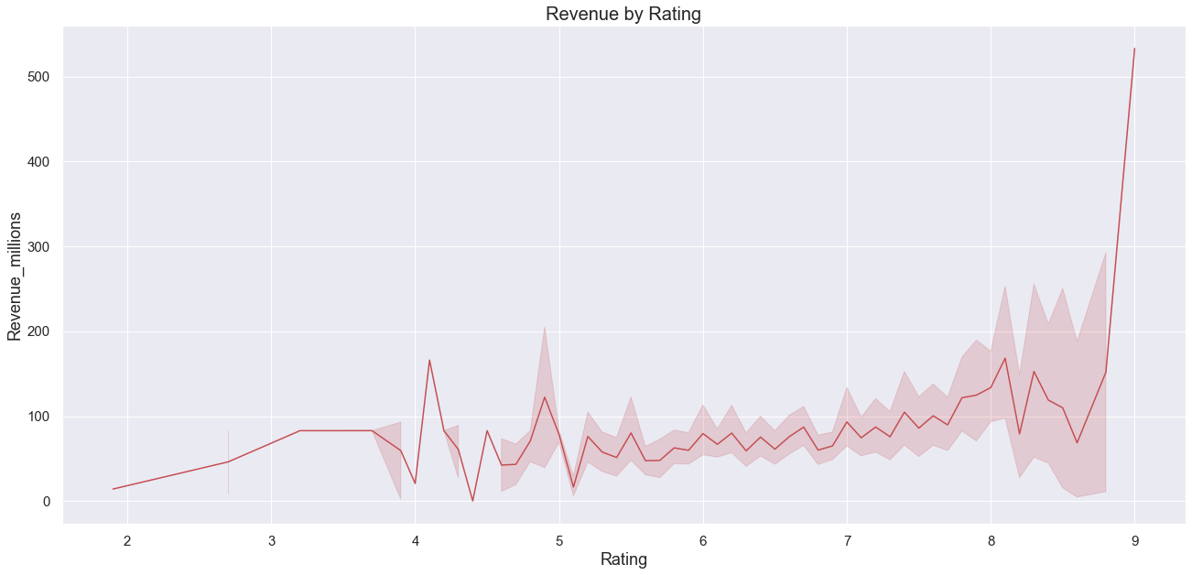
How Revenue is related with Rating of a movie?
In terms of business, revenue of movie, it strongly depends and related to rating, where user quite offen predict, if the movie is highly rating it is worth watching it. Which in return, increases the revenue.

Slide 12
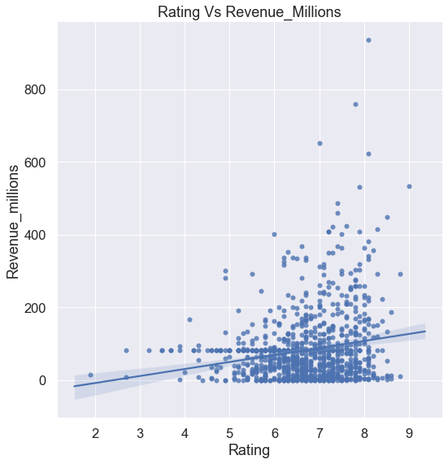
How Rating drives the Revenue generated of a Movie? we can observe how the rating drives the revenue, as the movies rated in between 6 to 8, the revenue generated is in between 0-150M approx, but if the rating goes higher it gives a impact on revenue.

Slide 13
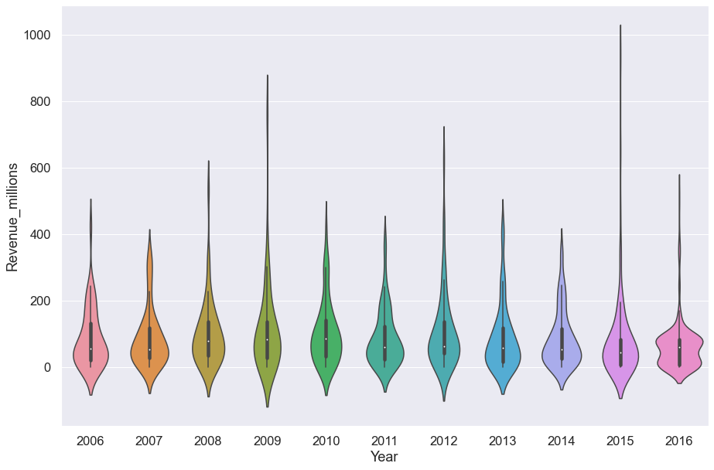
How Revenue (Million) is spread over the year? we can see the spread of Revenue data over the year. we can figure out 2016 is the highest in revenue, as in the previous analysis 2016 was high in movie production.

Slide 14
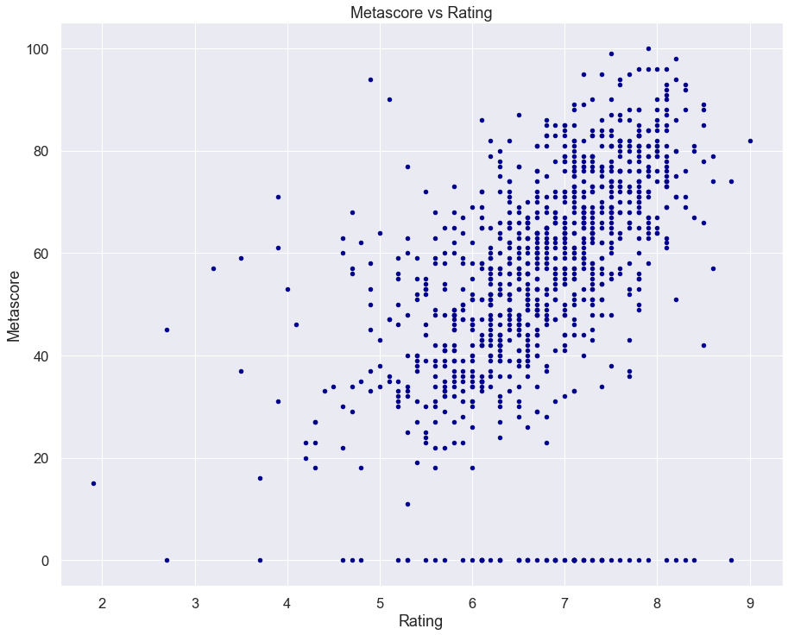
How Rating and Metascore are inter-related?
We can see all movies rated in between 6 to 8 have more critics reviews.
Higher the Rating, higher is critic's reviews (Metascore), higher is the revenue.

Slide 15
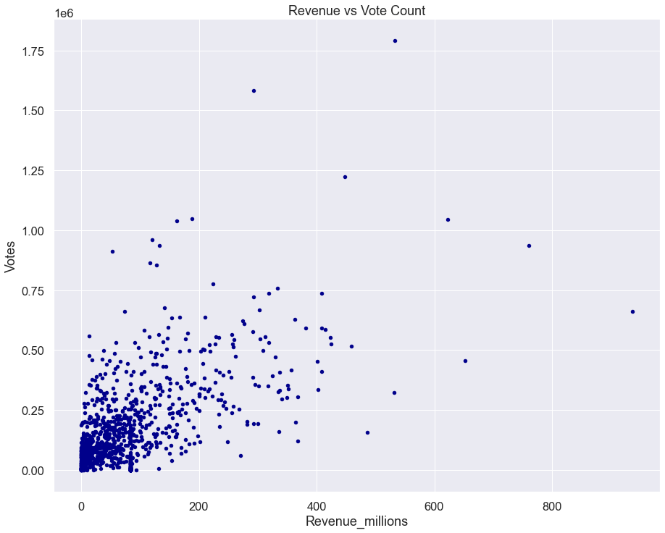
How Revenue is affected by Vote Count?
Most of the movies around 100-150 million have votes count under 0.25M, as the Vote count goes high, so is the revenue but it is not often.
There are movie with revenue more the 600-800M+ with votes 0.68 -1.00M approx., and movies with 400-600M with votes 1.75M+. There might be a exceptional case.

Slide 16
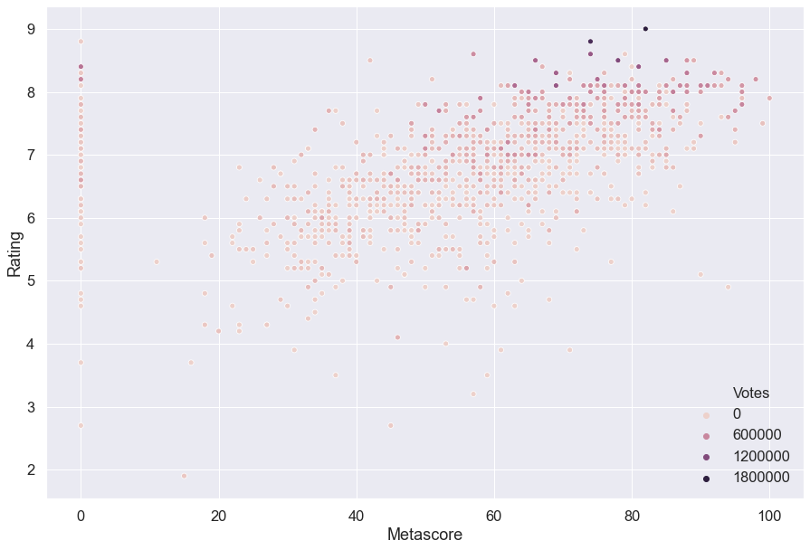
How Metascore and Rating is correlated with the Votes count?
As per the below analysis Metascore, Rating and Votes count go somewhat hand-in-hand. The dark spots shows high vote count for Metascore (70-80+) and Rating (8.2 - 9).

Slide 17
Conclusion: After analyzing the 1000 movies data, following is the conclusion of the observation-
As the Genre count increases in a movie, its Revenue, Rating and Metascore are on the rise. However, revenue is significantly high for movies with Genre count of 3.
The most popular Genre is Drama and the Genre combination of "Animation, Drama, Fantasy" earns the highest Rating. Also Drama is popular among Critics as well, with the Genre combination of "Drama, Fantasy, War" earning the highest Metascore. Where War, Musical and Western genre are lowest earners.
Average revenue per genre in past few year is been segregated the total revenue and Votes too, as the number of movies releasing has been increased over the years.
Number or the total_no of movies increased over the years, which could be the reason in decreased average revenue.
Short length movies or medium length are highly proposed/preferred by the users.
Actionable Insights: If you’re looking to dive into the ultimate film Genre, Director/Actors, Runtime, below are the insight to be kept in mind:
There should be mixed bags of Adventure, Drama, Animation, Sci-fi /Thriller and lot Action, which drive the User Crazy...
Produce movies with active directors & famous most liked Actors/Actress, as it is changing trend in nature. We can say that a particular Director is going to perform business drive in a liner fashion similar with cast of the movie. Becoz, direction depends on different parameters like story, budget, crew, technology and many more. Similar with Cast as they fluctuate in a timely & Trendy fashion.
Produce movies that have runtime not more than 2-2nhalf hours, lengthy the movie, user get exhausted. if you have noticed, NetFlix and other entertainment groups have introduced series with multiple episodes of 40-45 mins runtime.
Produce movies that will satisfy both People and Critics, for a business prospective & growth. As to shorten the research factor User usually visit critics reviews/rating section from various online channels to conclude to watch movie.

Slide 18


